Slide 1
Microsoft Movie Project
By : James Kahugu

Slide 2
Overview
This project analyzes the movies from box office over a few years. It shows the movie titles, studios and both foreign and domestic gross of the movies. Microsoft can use this data to help them get started with the new movie project.

Slide 3
Business Problem
Microsoft want to join in the fun of movie production and this analysis is to help the lead team of microsoft decide on what movies to venture in.
Microsoft can consider the studio and also type of movies in order to jump into the fun of creating movies to ensure that the movies have a good audience.

Slide 4
Data
Box office have a very big dataset on movie title,studio and both the domestic and foreign gross. The data files contain the movie title,studio and also the domestic and foreign gross.

Slide 5
Methods
This project has descriptive analysis,including the distributions. This provides a useful overview of the box office movie distributions trend over time.

Slide 6
Results
Most sample movies seem to be evenly distributed with an animation having the highest distribution.

Slide 7
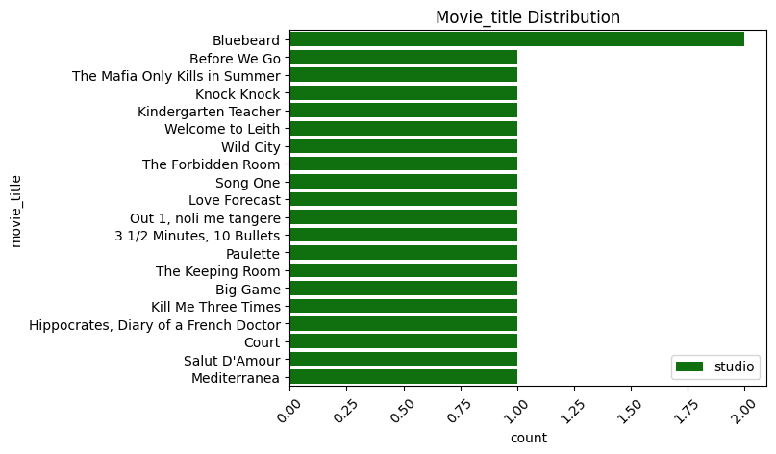

Slide 8
Conclusion
This analysis leads to a few recommendations for starting on movies creation.
*MOVIE TYPE
Movies that have a lot of science fiction and animations seem to have a higher distribution thus having a good performance overall.
*STUDIO CHOICE
Choosing the right studio to work with in the movie production industry also plays a key role on the overall performance of the movies.
*MARKETING
The team should focus on the right market plans as seems the movies have a relation in both foreign and domestic gross.

